Slide 1
Telecom Churn Prediction Project
Presented by
Meghana H

Slide 2
Index
Finding problem statement
Exploratory data analysis
Data visualization
Feature engineering
Model building
Hyper parameter tuning
Model evaluation
Model deployment

Slide 3
Problem Statement

Slide 4
Business Objective: Customer churn is a big problem for telecommunications companies. Indeed, their annual churn rates are usually higher than 10%. For that reason, they develop strategies to keep as many clients as possible. This is a classification project since the variable to be predicted is binary (churn or loyal customer). The goal here is to model churn probability, conditioned on the customer features.
Maximize the Company's profit by retaining customer
Minimize the Customer churn by identifying the key cause of the problem
2. The main objective of the project is to:
Finding factors and causes that influence customers to churn.
Retain churn customers by taking appropriate steps
Providing offers based on affecting factors.

Slide 5
Problem Statement
The problem statement is to model the probability of customer churn for a telecommunications company. The objective is to predict whether a customer is likely to leave or stay with the company based on customer features such as state, account length, type of plan, call duration, charges, and customer service calls. The goal is to develop a binary classification model that accurately predicts customer churn and identify factors that contribute to churn. The final output of the project is a deployed model using Flask or Stream lit that can be used to predict customer churn and help the company retain more customers.

Slide 6
Exploratory Data Analysis

Slide 7
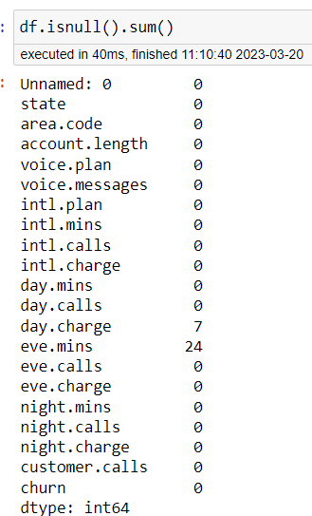
EDA
Exploratory Data Analysis (EDA) is an important step in understanding and gaining insights from churn data. Churn refers to the rate at which customers stop doing business with a company, and analyzing churn data can help companies identify the factors that contribute to customer attrition and take steps to reduce it.
The aim of EDA is finding missing values and outliers in dataset and remove them.

Slide 8
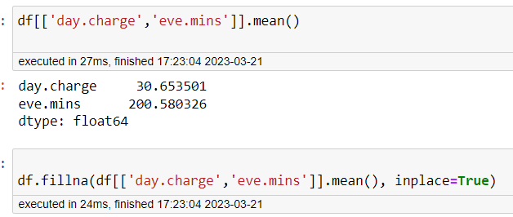
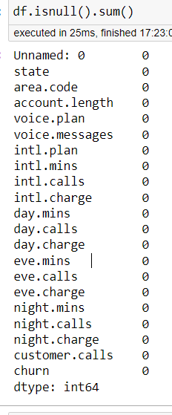

Slide 9
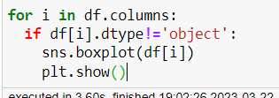
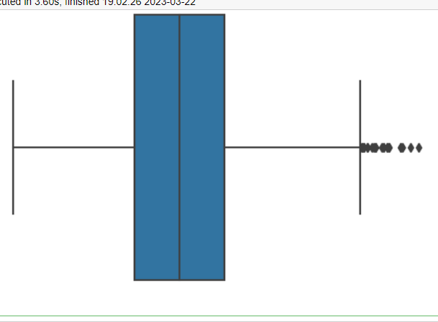
Account.length
Voice.messages
Intl.mins
Intl.calls
Intl.charge
Day.mins
Day.calls
Day.charge
Eve.mins
Eve.calls
Eve.charge
Night.mins
Night.calls
Night.charge
Customers.calls
These columns having outliers

Slide 10
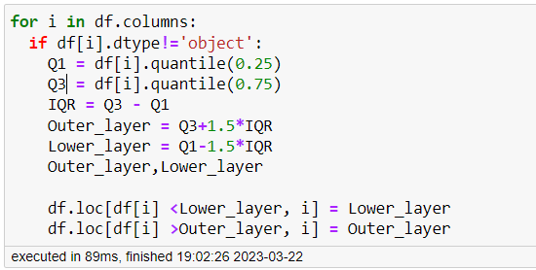
Using below code to remove the outliers

Slide 11
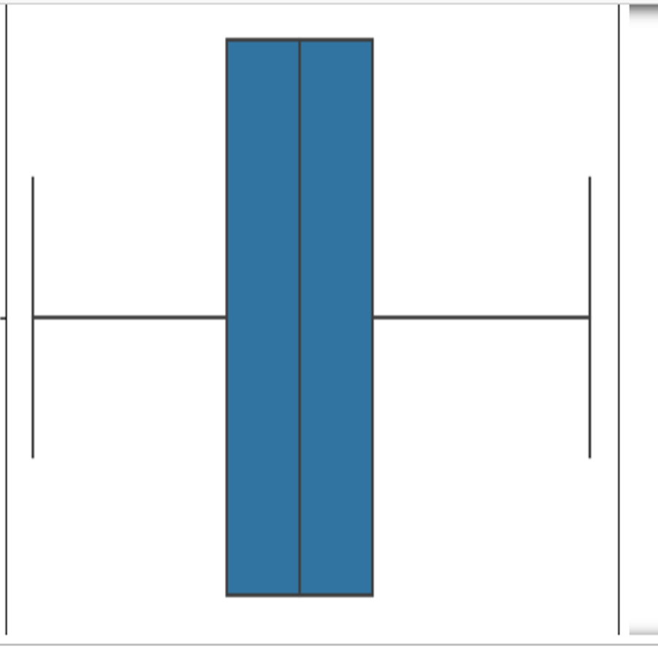
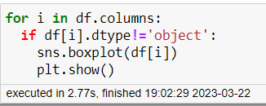
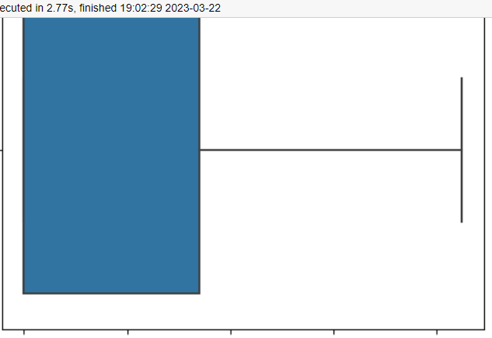
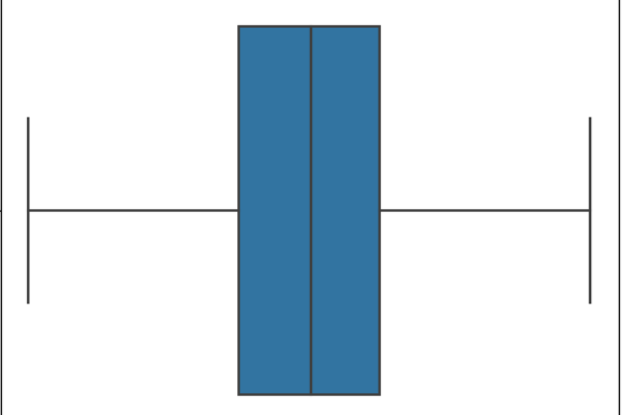
After removing the outliers

Slide 12
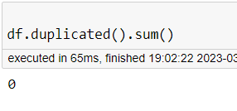
Duplicated Records

Slide 13
Data Visualization

Slide 14
Data Visualization
Data Visualization is the graphical representation of information
Visualizations achieved in this project are:
Pie chart
Count plot
Bar graph
Scatter plot
Heat map
Histograms

Slide 15
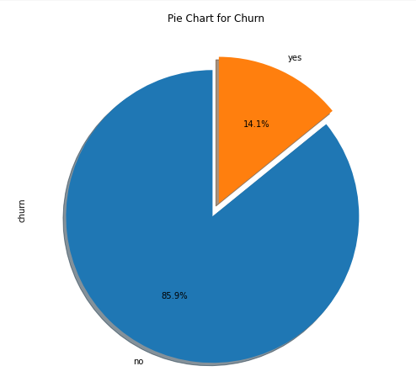
Pie chart plotting target feature distribution
From the above graph , 85.9% of customers are retained and 14.1% of customers are churned.

Slide 16
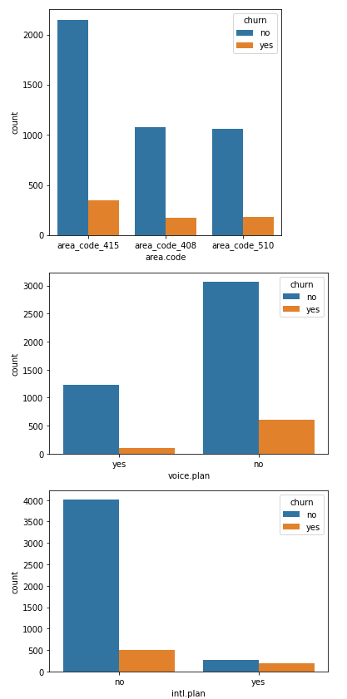
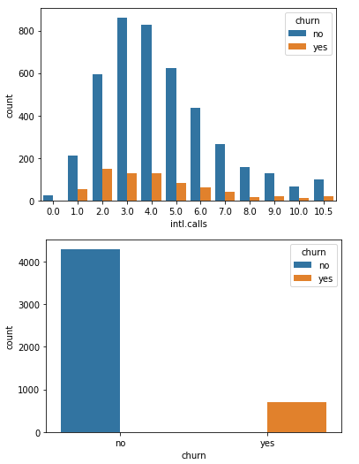
Count plot
This method is used to show the counts of observations in each catogarical bin using bars.
Plotting the relation of target attribute with other independent variables

Slide 17
From the plot:
Area code : People at area_code_415 are churning more compared to other area code
Voice plan : People who don't have voice plan are churning a lot compared to people having voice plan
Intl plan: People having international plan and people who don't have international both are churning.
Intl calls: Churn rate decreases above 4 calls
Recommendation :
Based on this the company may start providing voice and Intl plans for less cost so that the churn rate may decrease.

Slide 18
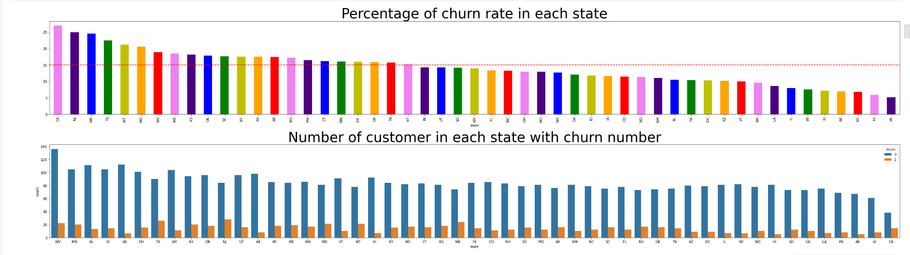
Bar chart & Count plot
Is a graph that represents the category of data with rectangular bars with lengths and heights that is proportional to values which they represent
A bar chart describes the comparisions between the discrete categories.
Above plot shows percentage of churn rate at each unique feature of state,
Only some of the states are having more churn rate, we need to improve the plans on those state.

Slide 19
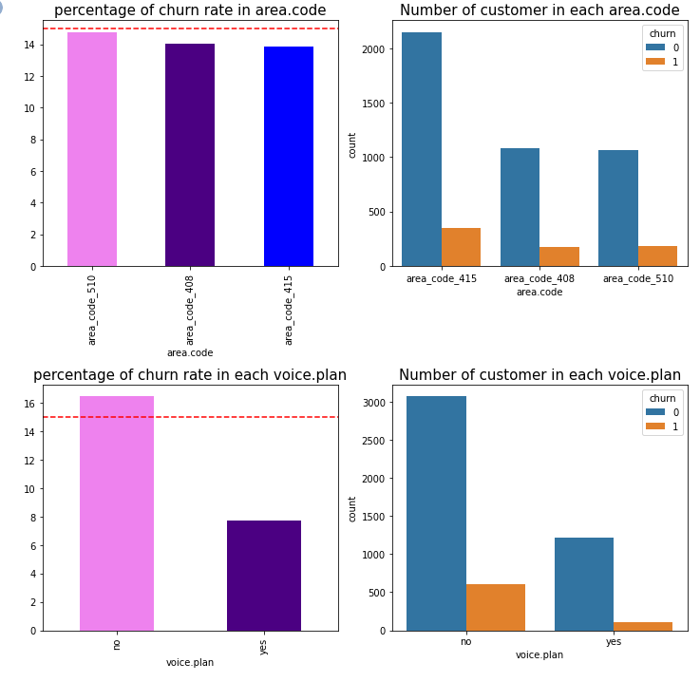
Above plot is showing percentage of churn rate at each unique feature of area code and voice plan, also plot shows numbers of customers with churn rate ( yes or no ) area code having less churn rate and it is limited to acceptable so no need to improve any plan in the area code but in the voice plan customers who don't have voice plan are churning a lot compared to people having voice plan so we need to retrieve the customer who are not using voice plan

Slide 20
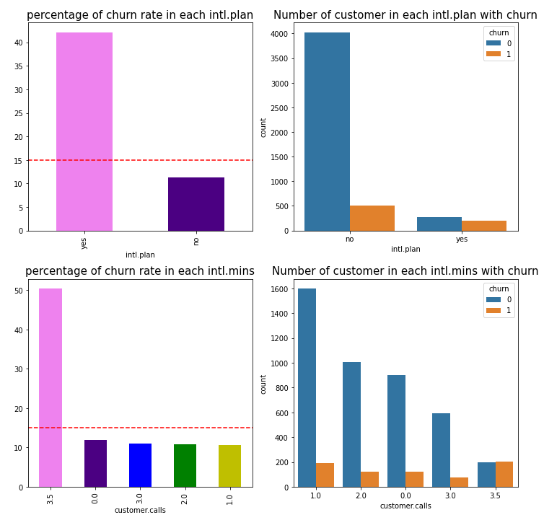
People having international plan are churning more.
In the plot (customer calls) above 3 calls there is more churn rate so we need to improve the customer services

Slide 21
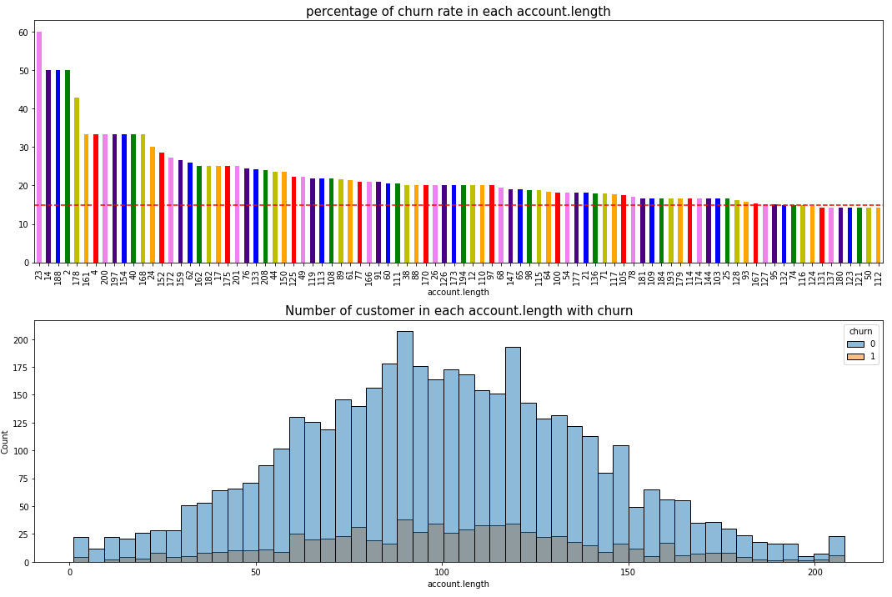
This plot is showing gaussian distribution and percentage of churn rate at each unique feature of account length .
The median having more churn rate so we need to improve the plan to customers between the range 50 to 150.

Slide 22
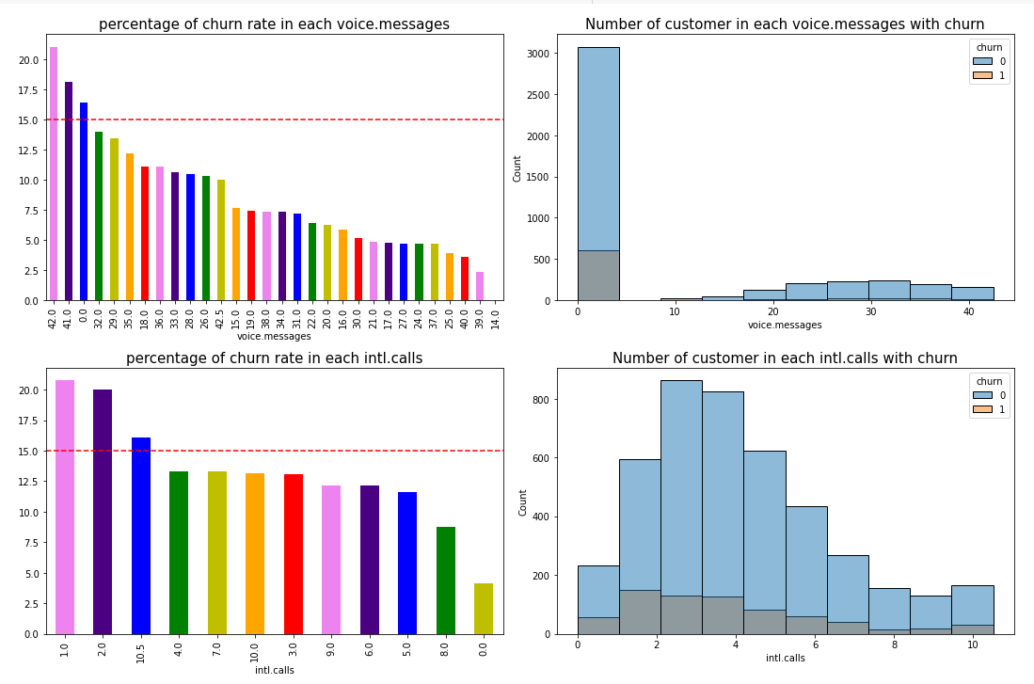
voice massage plot is showing there is more churn rate in customers who sends more than 40 msgs and the number of customers is also less so we need to alter the voice massage plan to retrieve the customers .
In international calls the churn rate is more at 0 to 6 calls so we need to update the international call plan.

Slide 23
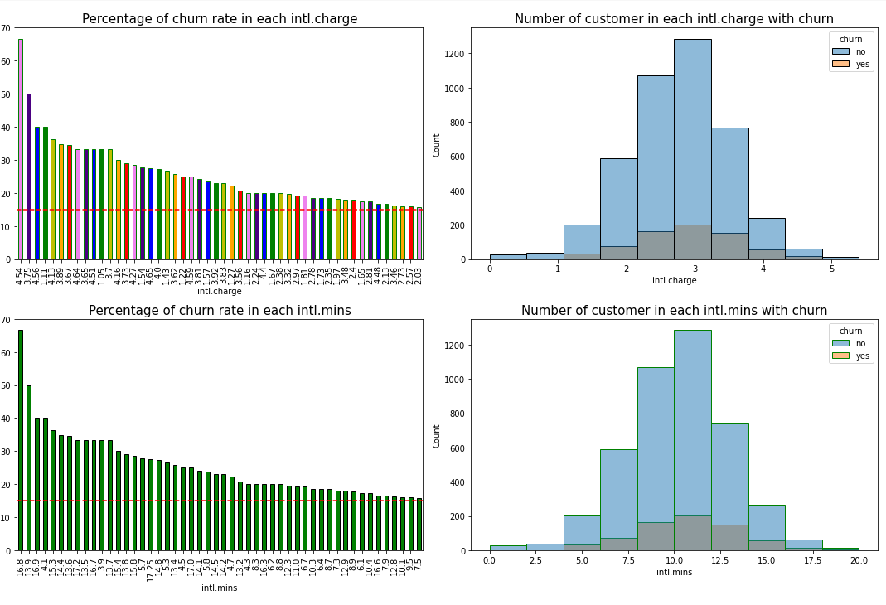
International charges and international mins having more churn rate so we need to update the international plans.

Slide 24
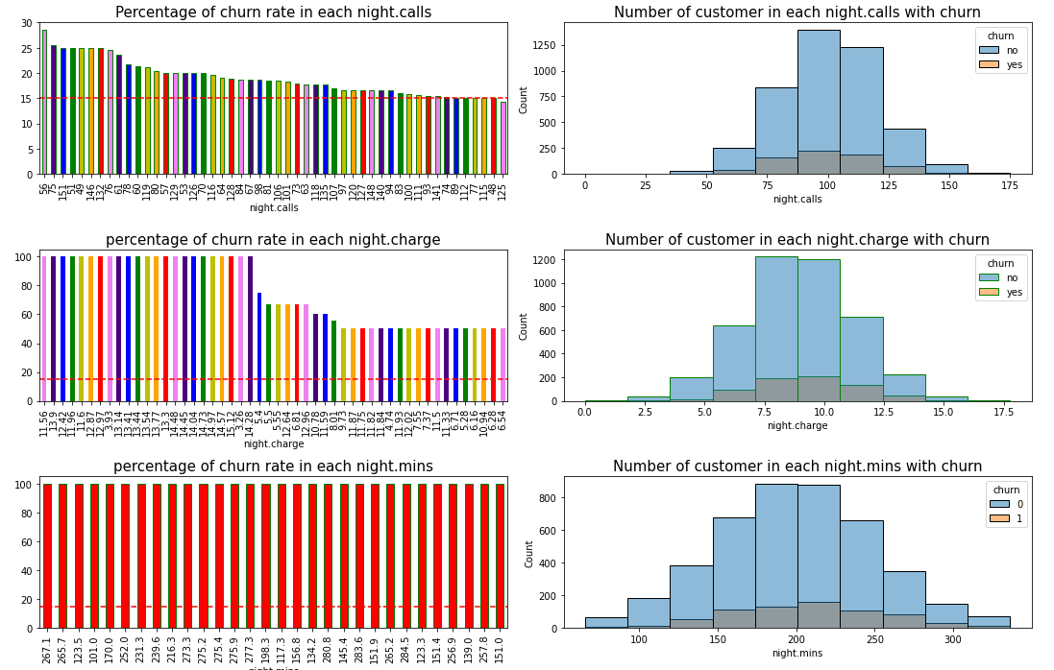
night charges,night calls and night mins having more churn rate so we need to update the night plans.

Slide 25
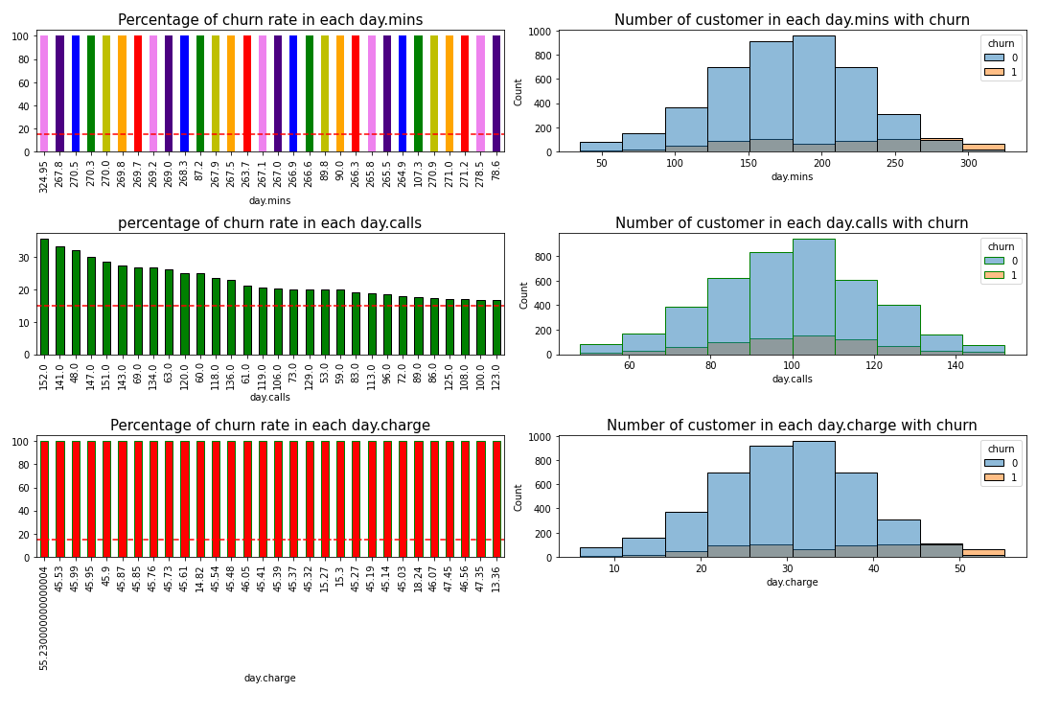
day charges,day calls and day mins having more churn rate so we need to update the day plans

Slide 26
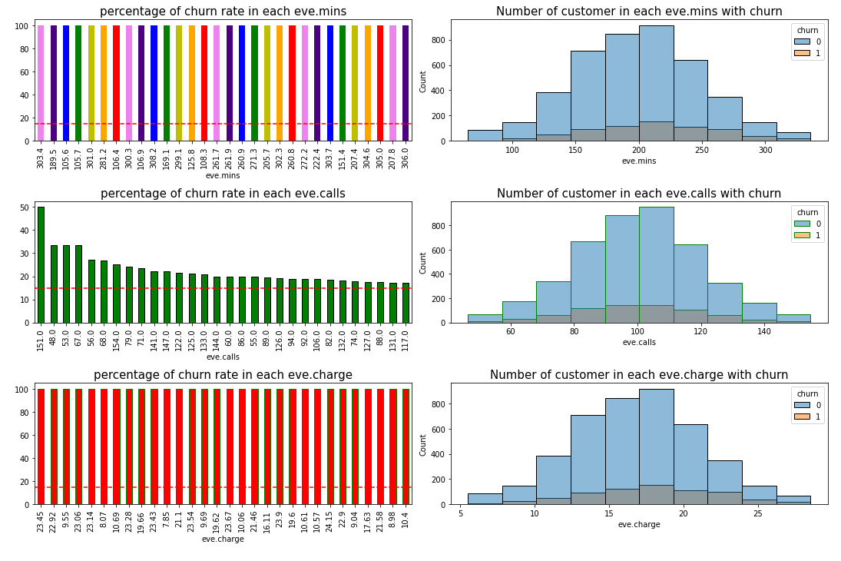
eve charges,eve calls and eve mins having more churn rate so we need to update the eve plans

Slide 27
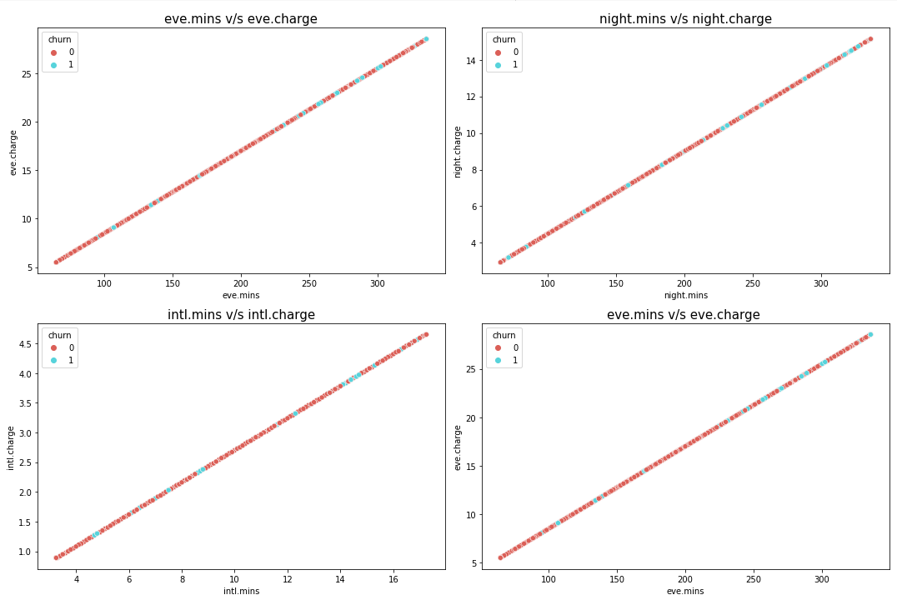
Scatter plot
A scatter plot is a diagram where each value is represented by a dot.

Slide 28
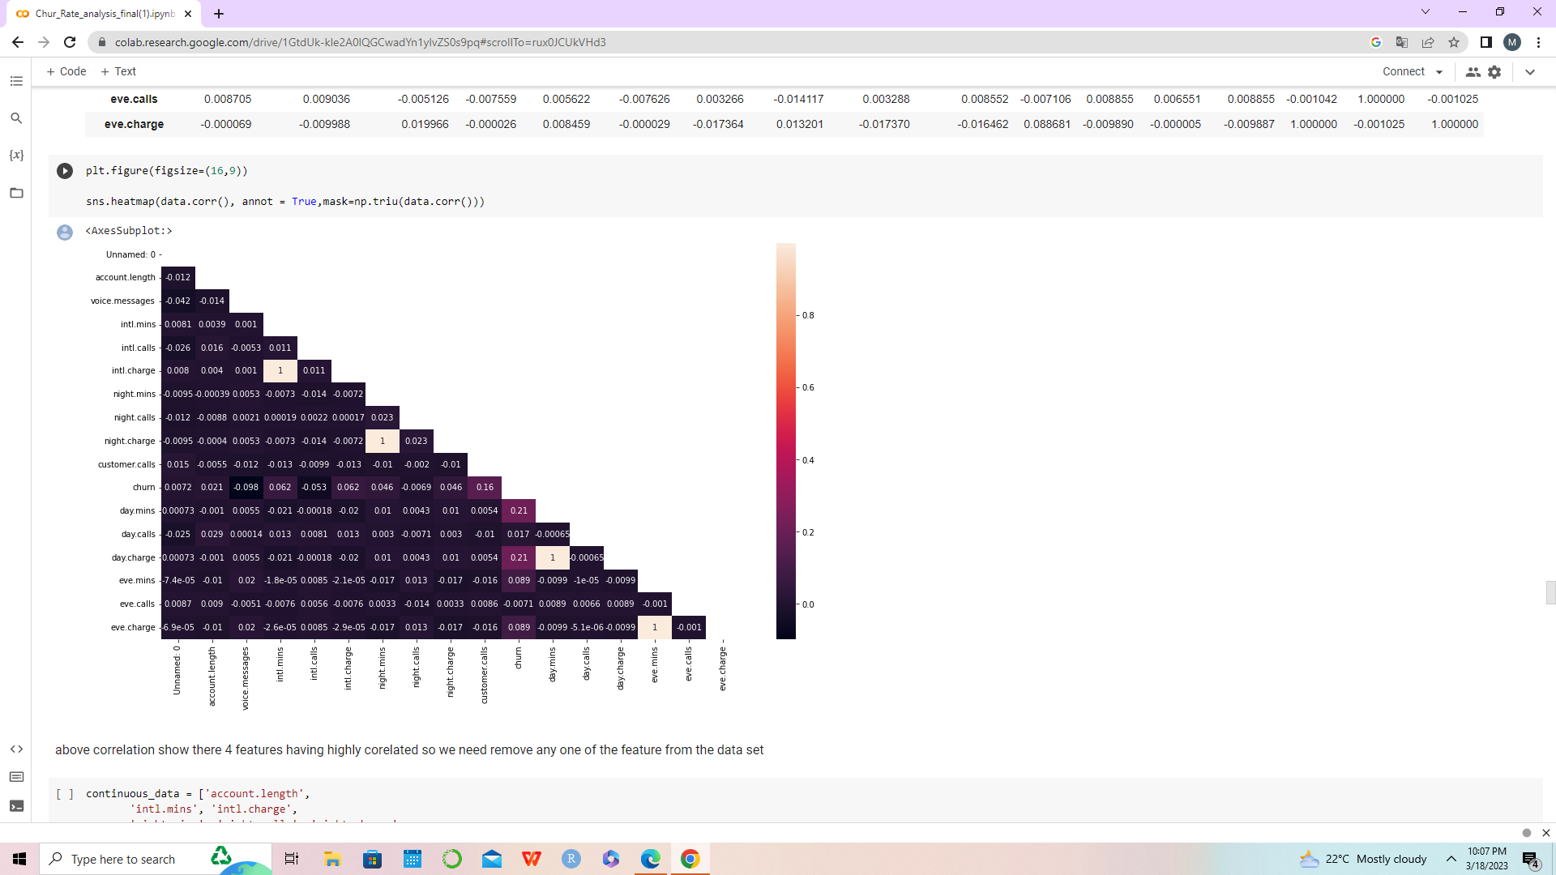
Heat map
Correlations between variables.
Correlation heatmaps can be used to find potential relationships between variables and to understand the strength of relationships.
Variable intl.charge & intl.mins, night.charge & night.mins, day.charge & day.mins , eve.charge &eve.mins are having positive correlation.

Slide 29
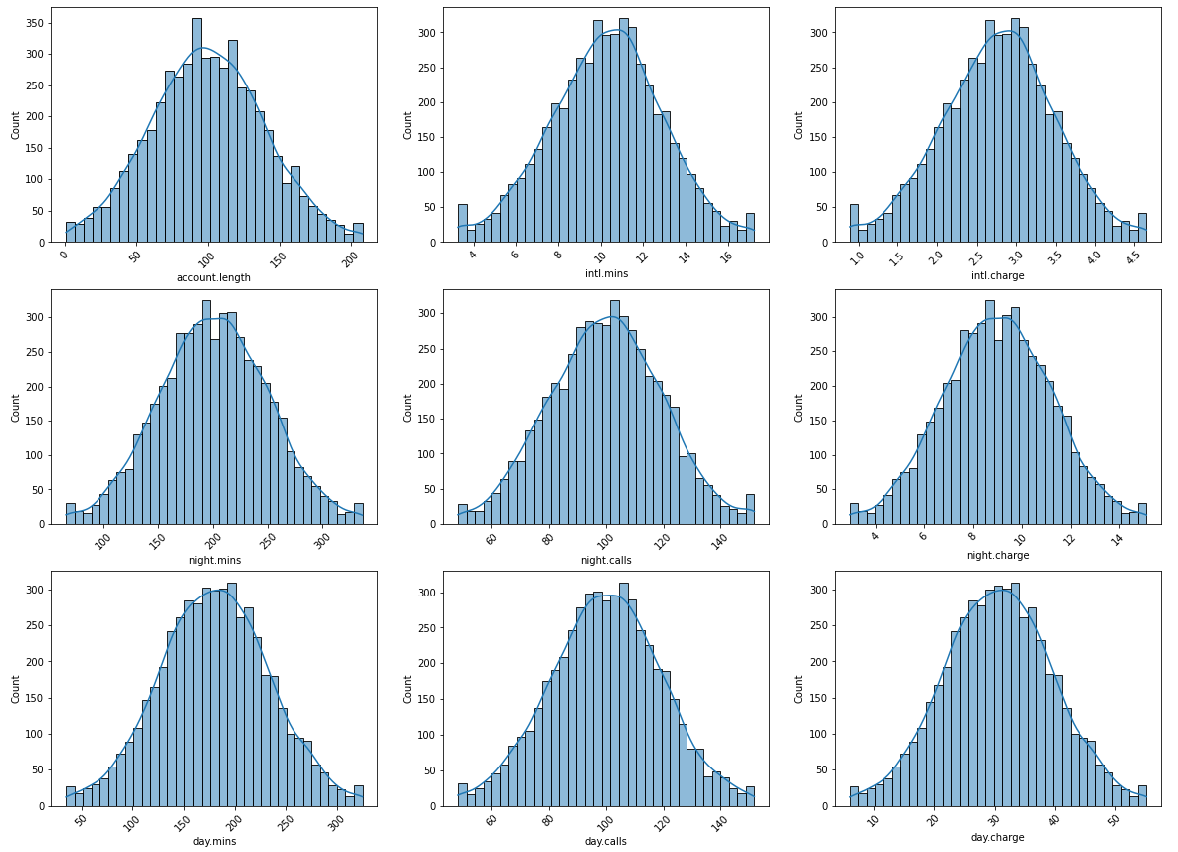
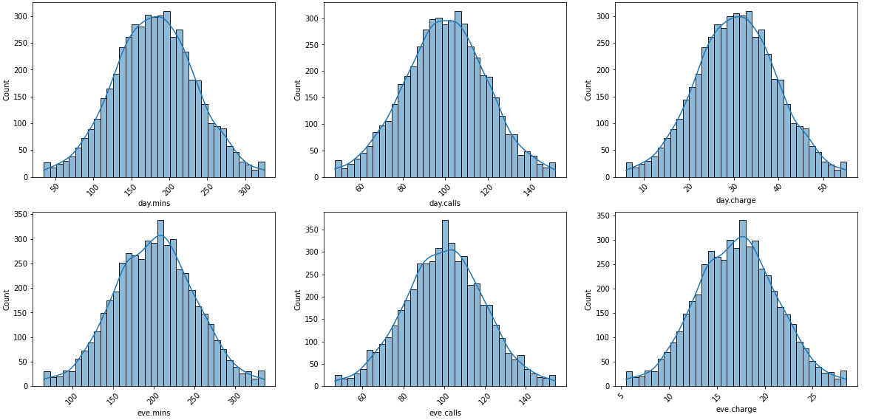
Histogram
The seaborn.histplot() method helps to visualize dataset distributions.
All the Hist plot shows all the numeric variables are normally distributed.

Slide 30
OVERALL CONCLUSION :-
After performing exploratory data analysis on the data set, this is what we have incurred from data:
1. There are some states where the churn rate is high as compared to others may be due to low network coverage.
2. Area code and Account length do not play any kind of role regarding the churn rate so,it's redundant data columns.
3. In the International plan those customers who have this plan are churn more and also the international calling charges are also high so the customer who has the plan unsatisfied with network issues and high call charges.
4. IN the voice mail section when there are more than 20 voice-mail messages then there is a churn so it basically means that the quality of voice mail is not good.
5. Total day call minutes, total day calls, Total day charge, Total eve minutes, Total eve calls, Total eve charge, Total night minutes, Total night calls, Total night charge, these columns didn't play any kind of role regarding the churn rate.
6. In international calls data shows that the churn rate of those customers is high, those who take the international plan so it means that international call charges are high, also there is a call drop or network issue.
7. In Customer service calls data shows us that whenever an unsatisfied customer called the service center the churn rate is high, which means the service center didn't resolve the customer issue.

Slide 31
RECCOMENDATIONS:-
1. Improve network coverage churned state
2. In international plan provide some discount plan to the customer
3. Improve the voice mail quality or take feedback from the customer
4. Improve the service of call center and take frequently feedback from the customer regarding their issue and try to solve it as soon as possible

Slide 32
Feature Engineering

Slide 33
Feature Engineering
1
One Hot Encoding
2
Feature Selection
3
Data Balance
Splitting Data into Test & Train
Renaming Columns
Dropping Features
2) Decision Tree
3) Chi Square
Pre Processing Data
1) Random Forest Classifier Model

Slide 34
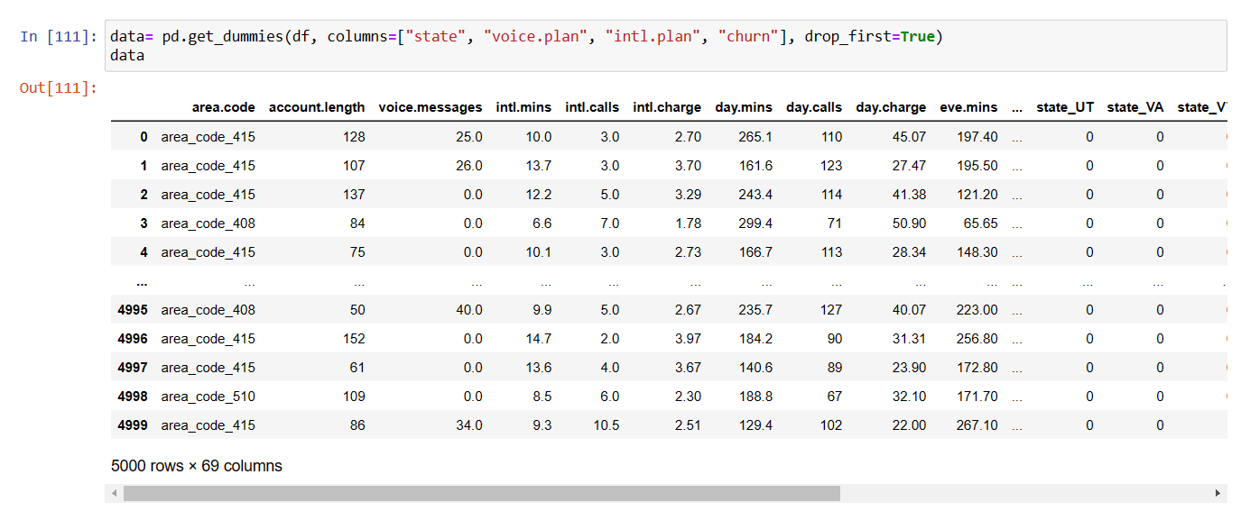
One Hot Encoding
One hot encoding is one method of converting data to prepare it for an algorithm and get a better prediction. With one-hot, we convert each categorical value into a new categorical column and assign a binary value of 1 or 0 to those columns. Each integer value is represented as a binary vector. All the values are zero, and the index is marked with a 1.

Slide 35
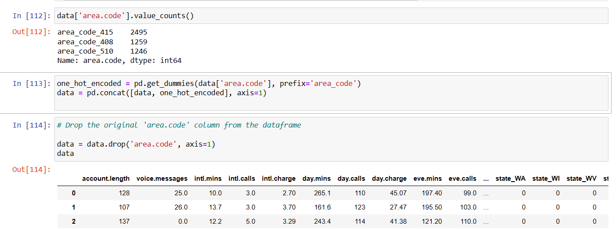
In one hot encoding, we used get.dummies method for columns like ‘state’, ‘voice.plan’, ‘intl.plan’, ‘churn’. And also for ‘area.code’ but saperately.
After that concatination of both get.dummies are done.
Then dropped ‘area.code’ column, as it was not creating any impact on Churn feature. (we get this conclusion from EDA & Visualization)

Slide 36
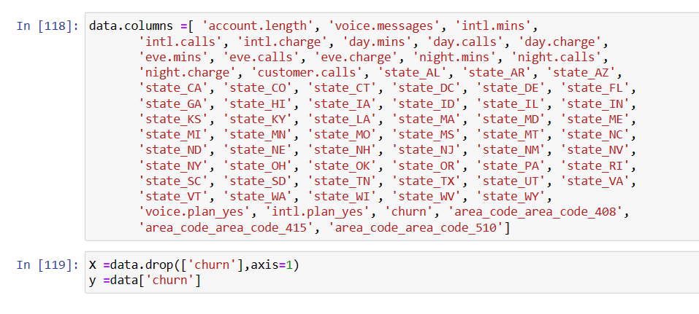
Renaming Column Names
Renaming column names helps for better understanding between original features and dummy features.
Dropped Churn feature as it is target feature.

Slide 37
Feature Selection
To get ‘feature importance’, we performed 3 methods such as follow and compared which method gives best ‘feature importance’.
Random forest classifier
Decision tree
Chi Square
We can get top 10 features which create maximum impact on ‘Churn’ feature with help of ‘Feature importance’.

Slide 38
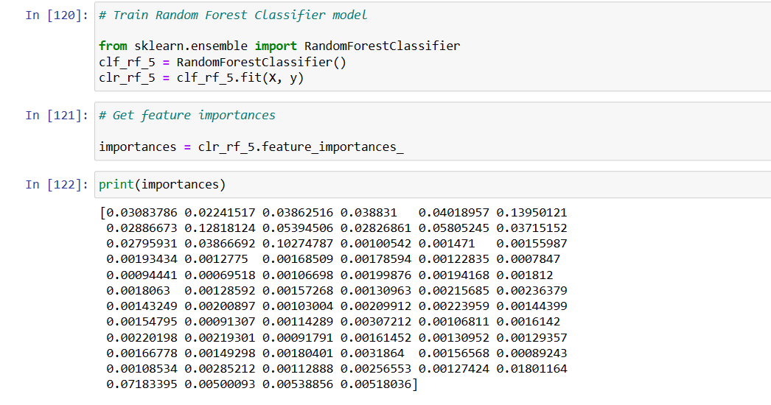
Random Forest Classifier

Slide 39
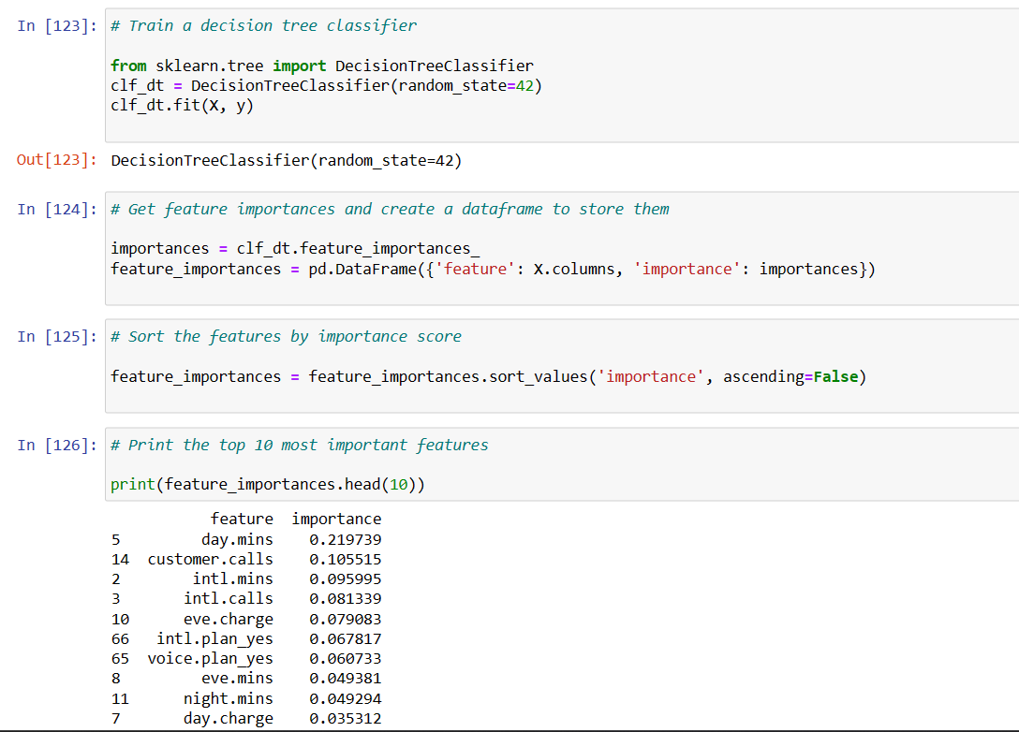
Decision Tree

Slide 40
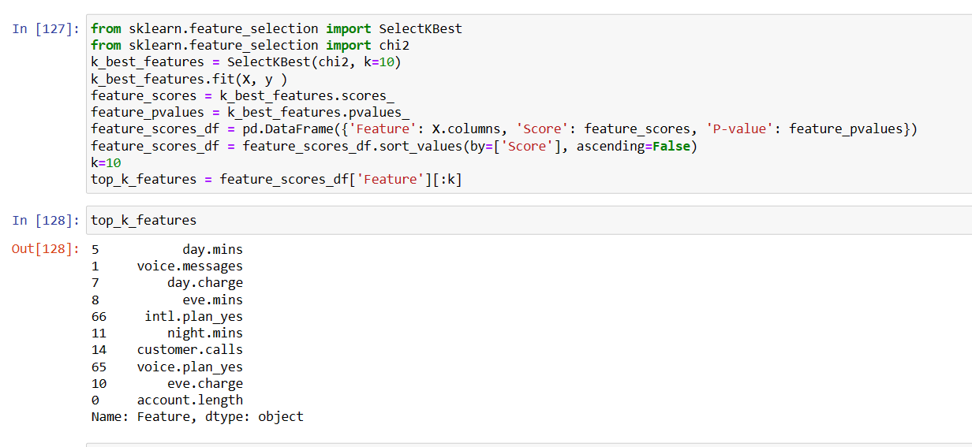
Chi Sqare
Conclusion :- All 3 methods are giving almost same feature importance

Slide 41
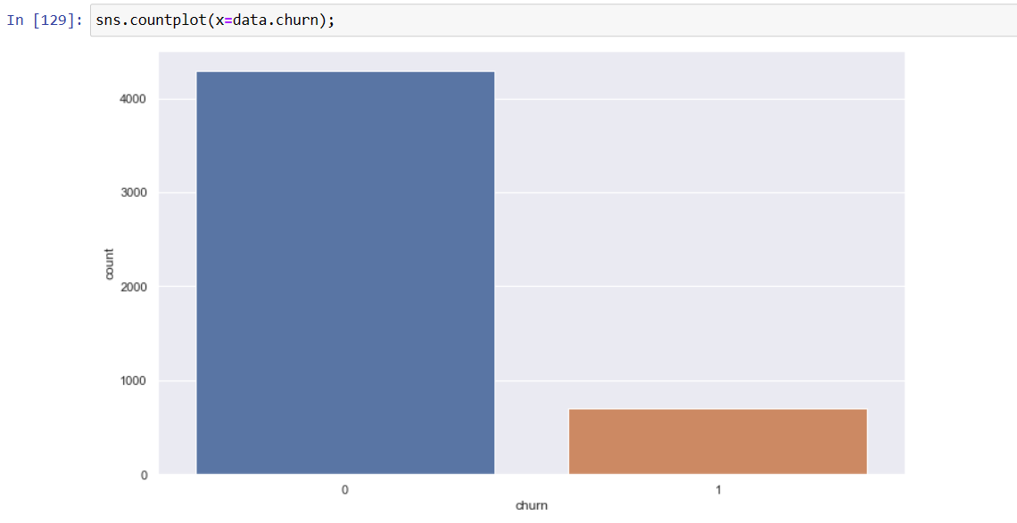
Churn Count Before Data balance
Target variable having imbalanced data so we need to Balance data by SMOTE method to Up sampling because data set is small

Slide 42
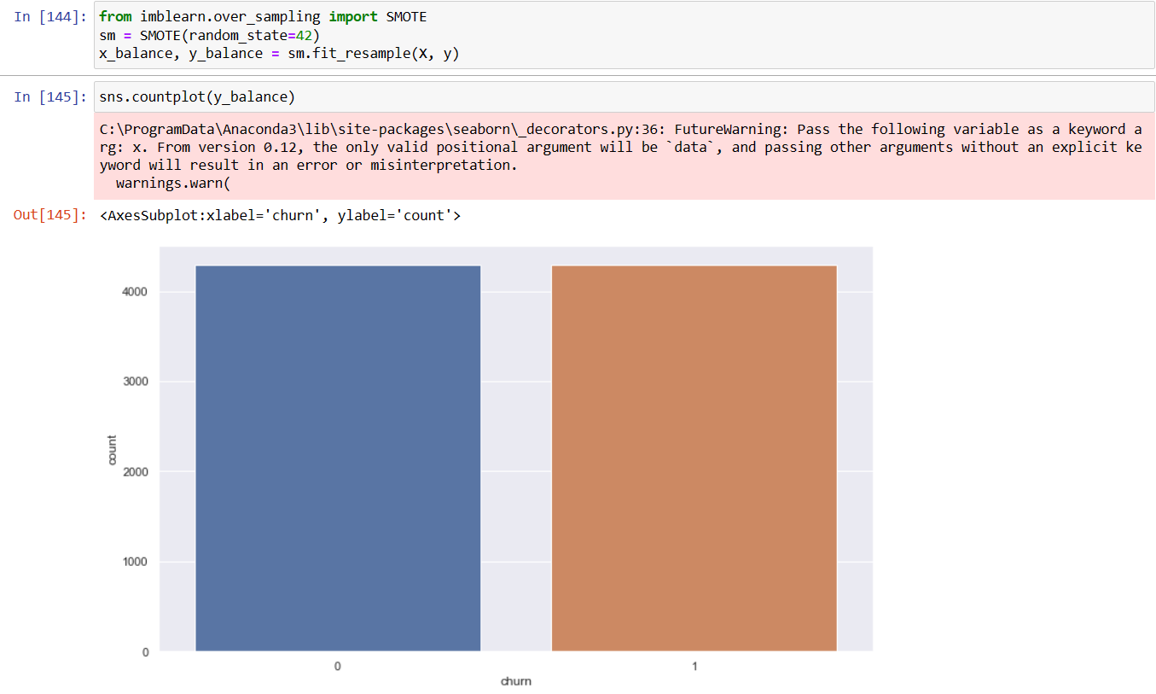
Churn Count After Data balance
Here, data is balance for target variable ‘churn’.

Slide 43
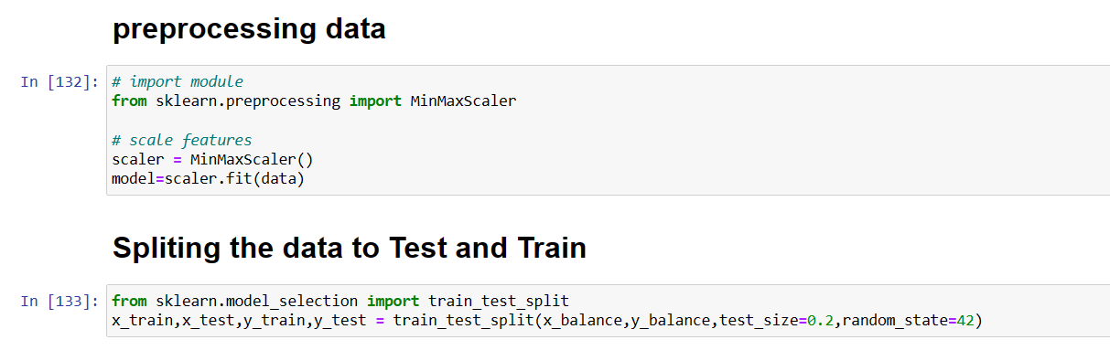
The following are some benefits of preprocessing data:
It improves accuracy and reliability. Preprocessing data removes missing or inconsistent data values resulting from human or computer error, which can improve the accuracy and quality of a dataset, making it more reliable. It makes data consistent. It increases the data's algorithm readability.
Why we split data into train and test ?
Whenever we train a machine learning model, we can’t train that model on a single dataset or even we train it on a single dataset then we will not be able to assess the performance of our model. For that reason, we split our source data into training, testing, and validation datasets.

Slide 44
Model Building

Slide 45
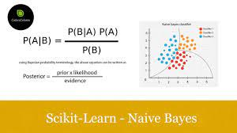
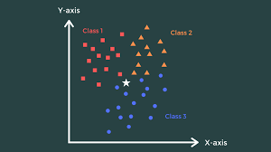
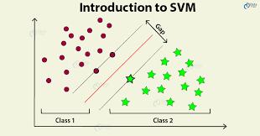
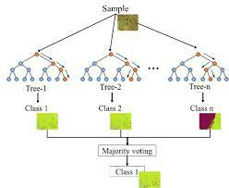
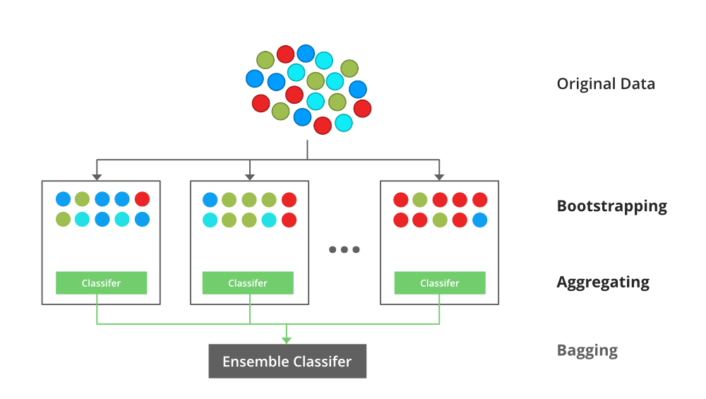
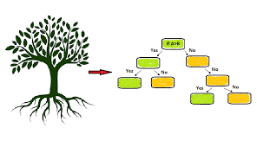
Model Building
Naïve Bayes
KNN
SVM
Decision Tree
Random Forest
XGBclassifier

Slide 46

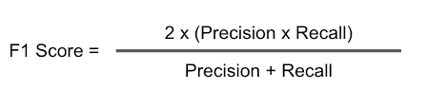


MODEL EVALUTION
Model evaluation is the process of using different evaluation metrics to understand a machine learning model's performance, as well as its strengths and weaknesses.
Precision (Positive Predicted Value)
Recall (Sensitivity, True Positive Rate)
Receiver-Operator Curve (ROC Curve)
Area Under the Curve (AUC)
Accuracy
F1- score

Slide 47
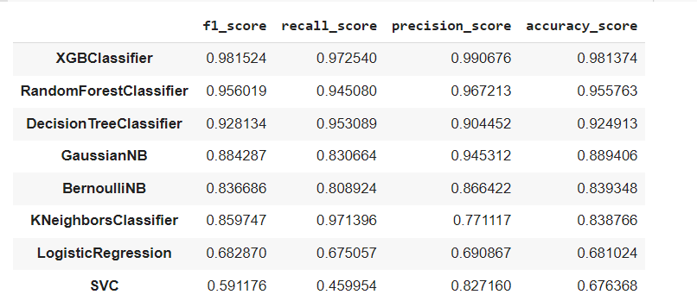
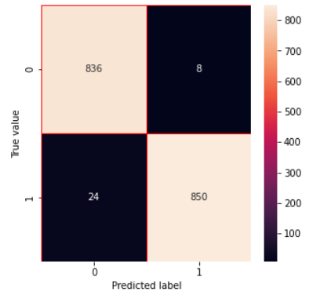
The most important metric used is Recall.
Recall reveals the proportion of churns identified correctly by the total number of churns.

Slide 48
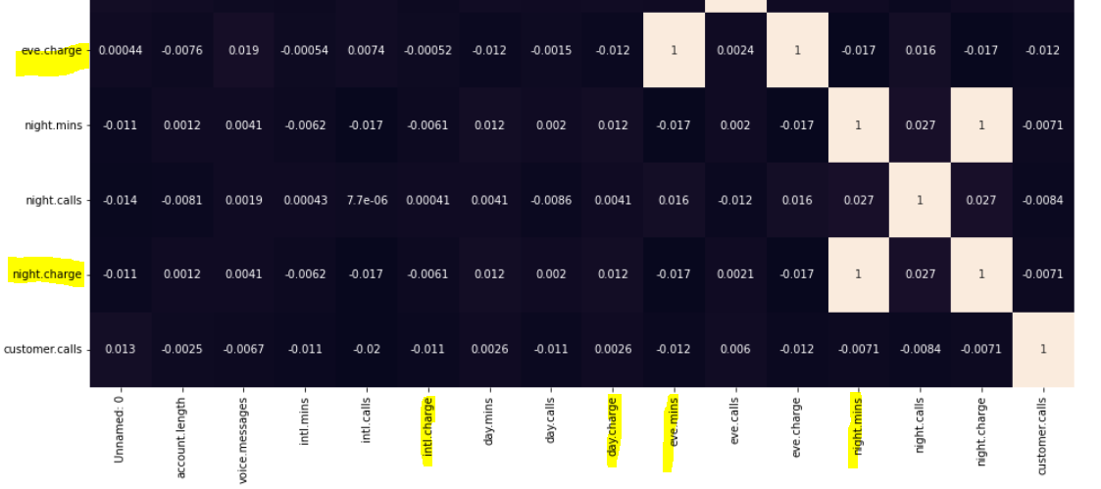
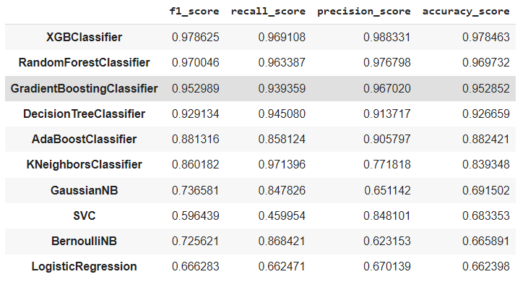
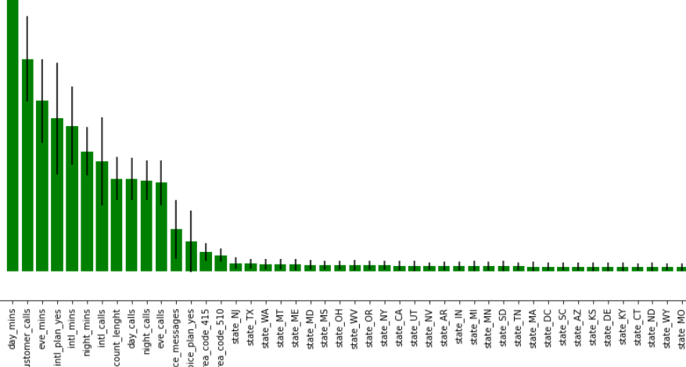
FEATURE ELIMINATION
We need to reduced the feature using feature importance of random forest and correlation matrix to eliminate the features finally we got the accuracy 97% with only 13 features

Slide 49
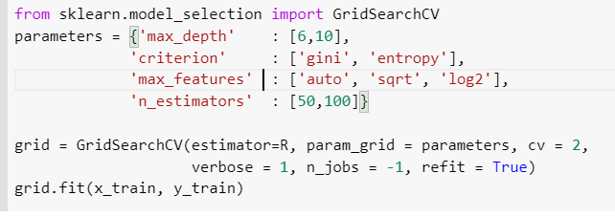
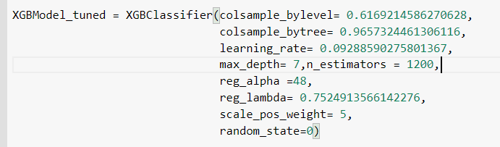

Random Forest
Hyperparameter Tuning
XGBClassifier
There is no improvement in the hyperparameter tuning so we need finalise the without hyperparameter tuning

Slide 50

Feature scaling, we are using min-max scaler
But there is a improvement in the SVC and Logistic regression and KNN but in this also XGBclassifier has more accuracy so we need to finalize the XGBclassifier model
Feature scaling

Slide 51
Model Deployment

Slide 52

Deployment Of ML
1. Create pickle file
2. Create Environment
3. Install required libraries
4. develop app by using spider
5. Using local host run in streamlit

Slide 53

After model evaluation we got xgboost classifer have more accuracy(97.6%) than others so we have selected that model for deployment
First we have to import pickle and create pickle file with respect to model

Slide 54

From prompt create environment

Slide 55

After successfully creating environment activate this environment
Next step is installing libraries which we needed for model deployment

Slide 56


In spider we can develop app.py by imputing programme
Here we develop an app according to our model features and condition putting textbox , selectbox
By this we get output such as “customers has been churn or customers has not churn”

Slide 57

Then we have give path of app.py file for running into streamlit

Slide 58

This is our streamlit page here we have added some visualizes form web
Adding information we get output

Slide 59

Also we can find out bigdata ouput by putting .csv file by changing online to batch and uploading .csv file

Slide 60
Thank you !

